Slide 1
SWE30003 Software Architectures and Design
Lecture 3
Quality Attributes,
Requirements Validation

Slide 2
Logistical matters
Weekly submissions – A & Q
Week 2: 104 & 101 out of 119;
Week 3: 101 & 98 out of 118;
Note that this is a hurdle requirement
No late submission
Assignment 1 Spec: … questions? … started? – start early

Slide 3
Question to Answer - Week 2
Describe the difference between Use Case diagrams and Task Descriptions. What are the advantages of using Task Descriptions as opposed to User Cases? Provide a situation where Task Descriptions are more suitable for use than Use Case Diagrams.
------
Notes:
Solution v problem domains
User-system separation
details

Slide 4
Principal References
Len Bass, Paul Clements, and Rick Kazman, Software Architecture in Practice (4th Edition), Addison-Wesley, 2021, Chapters 3 and 4. (chapters in previous editions of the same topics are reasonable replacements).
Ian Gorton, Essential Software Architecture, Springer, 2006, Chapter 3 (available from Canvas).
Soren Lauesen, Software Requirements - Styles and Techniques, Addison-Wesley, 2002, Chapters 6 and 9.
Allan R. Tucker (Ed.), Computer Science Handbook (2nd Edition), Chapter 101 - Software Qualities and Principles (available from Canvas).

Slide 5

Outline
Software Quality
Quality Models
Quality Attributes
Quality Attribute Scenarios
Requirements V&V

Slide 6
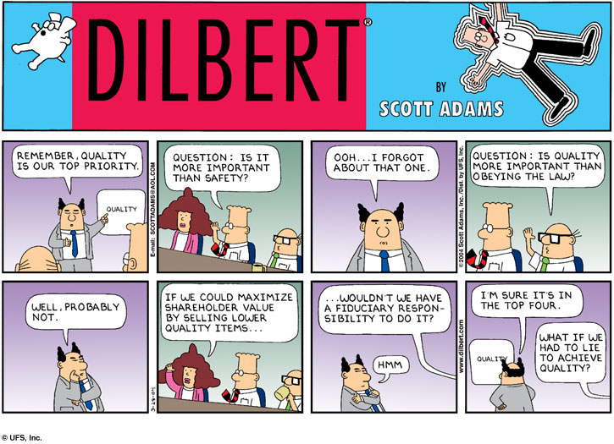
http://en.wikipedia.org/wiki/Fair_use
Notes:
Contradictions and conflict and priorities …

Slide 7
What is Quality?
ISO defines quality as “the totality of characteristics of an entity that bear on its ability to satisfy stated or implied needs.”
Some Related terms:
“Conformance to requirements” means that both the process and product of the project must meet the written specifications.
“Fitness for use” means that a product can be used as it was intended.
“Meeting customer needs” means that the product meets the (explicit and implicit) expectations of stakeholders.
Notes:
Conformance to requirements:
Software developers view the quality of software in this perspective.
Fitness for use:
Customers or users hold this view.
Kitchenham (1989) “quality is hard to define, impossible to measure, easy to recognise”
Gillies (1992) “Software Quality, Theory and Management”, Chapman and Hall, p 19-40
Quality is “transparent when presented, but easily recognized in its absence”
Dromey (1995) “A model for Software Product Quality” IEEE Transactions on Software Engineering, p 146-162

Slide 8
What is Software Quality?
Software Quality is conformance to:
explicitly stated functional and performance(quality) requirements,
explicitly documented development standards,
implicit characteristics that are expected of all professionally developed software.
Notes:
Pressman ch 17; Sommerville ch 30

Slide 9
Quality Requirements – Examples
Roster planning, Midland Hospital
R565. System modifications must be made in a development environment which ensures that modifications are included in new releases.
R570. The supplier must specify the program’s degree of portability.
R610. When typing a text with up to 300 characters a minute, there must be no observable delay between entry and display of the corresponding character.
R668. The system must not place unnecessary restrictions on the order in which the user performs functions and enters data.
What is “wrong” with these kinds of requirements?
Notes:
We can discuss these requirements in quite some detail… task for the ‘user’ to write them up in a better way…

Slide 10
What's Wrong With Those Requirements?
Problem: These quality requirements are not testable or measurable!
Req Issue Vague Term
R565 Process rule, not a system quality "development environment"
R570 Asks for documentation, not a quality "specify the degree"
R610 Subjective threshold — who decides? "no observable delay"
R668 No clear pass/fail criterion "unnecessary restrictions"
Good quality requirements must be SMART:
Specific | Measurable | Achievable | Relevant | Testable
❌ R610: "no observable delay" → ✔ "keystroke-to-display latency ≤ 50ms"
Key Takeaway: A quality requirement must have a clear, objective pass/fail test. If you can't write a test for it, it is not a good quality requirement — rewrite it with specific metrics (e.g., response time in ms, uptime %, error rate).

Slide 11
Problems with Software Quality
Software specifications are usually incomplete and often inconsistent with regards to quality.
There is tension between:
customer quality requirements (efficiency, reliability, etc.)
developer quality requirements (maintainability, reusability, etc.)
Some quality requirements are hard to specify in an unambiguous way
directly measurable qualities (e.g., errors/KLOC),
indirectly measurable qualities (e.g., usability, user “engagement”).

Slide 12
Problems with Software Quality – Explained
Problem 1: Specifications are Incomplete & Inconsistent
Quality goals are rarely written down precisely. Different stakeholders assume different things, leading to gaps and contradictions. E.g., "fast" means <1s to a user but <10s to a developer.
Problem 2: Tension Between Customer vs Developer Goals
Customer Needs
Efficiency, Reliability,
Usability, Security
Developer Needs
Maintainability, Reusability,
Testability, Portability
⚡ TENSION
Problem 3: Some Qualities are Hard to Specify
Type | Example Quality | How to Measure
✔ Direct | Reliability, Performance | Errors/KLOC, response time (ms)
⚠ Indirect | Usability, Engagement | Proxy metrics — task time, survey score
Key Insight: Indirect qualities must be broken into proxy metrics before they can be tested — otherwise they remain wishful thinking in the spec.

Slide 13
Outline
Software Quality
Quality Models
Quality Attributes
Quality Attribute Scenarios
Requirements V&V

Slide 14
Hierarchical Quality Model
Define software quality via a hierarchical quality model, i.e. a number of quality attributes (aka quality factors, quality aspects, etc.)
…
Availability
Quality attribute
Modifiability
may be further
Software
Performance
refined
into
Quality
sub-attributes
Security
Testability
Usability
Notes:
You should all be familiar with these from ISE or SDP…

Slide 15
Hierarchical Quality Model (cont.)
Availability: is the system providing the service it is supposed to when it is expected to?
Modifiability: can reasonable changes be made at reasonable cost?
Performance: does the system respond quickly enough to user input?
Security: can authorized users access the services of the system while unauthorized people cannot?
Testability: can the system be exercised to a degree that ensures confidence in correctness?
Usability: how easy is it for the user to do what is desired?
Notes:
These are the ones we will have a closer look at for the rest of this lecture…
There are chapters in the references (books) …

Slide 16
What about other Qualities?
Portability: the system must be changed to run on different hardware/operating system  modifiability
Maintainability (“fixing bugs”): the system must be changed to remove invalid/wrong behavior  modifiability
Scalability: the system must be changed to have more capacity (can handle more requests than currently, store more information, etc.)  modifiability
Operability: the system must be “easy” to use, being “easy” to learn etc.  usability
Reliability: the system must not fail “too often”  availability
Integrity: data of the system cannot be changed in an unauthorized manner  security

Slide 17
Model of McCall and Matsumoto
Operation
Integrity
Correctness
Reliability
Usability
Efficiency
Revision
Maintainability
Testability
Flexibility
Transition
Portability
Interoperability
Reusability

Slide 18
ISO 9126
Functionality
Accuracy
Security
Suitability
Compliance
Reliability
Maturity
Fault tolerance
Recoverability
Usability
Efficiency
Maintainability
Testability
Changeability
Analyzability
Stability
Portability
Adaptability
Installability
Conformance
Replaceability

Slide 19
McCall
Operation:
Integrity
Correctness
Reliability
Usability
Efficiency
Revision:
Maintainability
Testability
Flexibility
Transition:
Portability
Interoperability
Reusability
ISO 9126
Functionality
Accuracy
Security
Interoperability
Suitability
Compliance
Reliability
Maturity
Fault tolerance
Recoverability
Usability
Efficiency
Maintainability
Testability
Changeability
Analysability
Stability
Portability
Adaptability
Installability
Conformance
Replaceability

Slide 20
BREAK

Slide 21
Outline
Software Quality
Quality Models
Quality Attributes
Quality Attribute Scenarios
Requirements V&V

Slide 22
Quality Attributes
22
Quality attributes apply both to the product and the process.
product: delivered to the customer
process: produces the software product
resources: (both the product and the process require resources)
Underlying assumption: a quality process leads to a quality product (cf. metaphor of manufacturing lines).
This is not necessarily true for software! Perhaps the appropriate statement is: “A quality process is more likely to lead to quality software more often”.
Notes:
HIT3309 - Software Project Practices and Management
S1 2010
© Swinburne University of Technology
22
I have to elaborate a bit more on this…

Slide 23
Quality Attributes: Product, Process & Resources
The Three Quality Perspectives
Manufacturing vs Software Reality
Aspect | Manufacturing | Software
Process → Product link | ✔ Consistent, repeatable. Same process always yields same product. | ⚠ Creative, human. Good process improves chances but doesn't guarantee it.
Measurability | ✔ Defects per unit easy to count. Tolerances are physical. | ⚠ Defects are invisible. Usability & maintainability hard to measure directly.
Replicate product | ✔ Run the line again. Identical copy. | ✔ Trivial (copy a file) — but quality of the original still varies.
Quality control | ✔ Inspect output; reject defects at end of line. | ⚠ Must test extensively. Cannot inspect all paths — testing only shows presence of bugs.
PRODUCT
Delivered to customer
↑ produces
↑ consumes
PROCESS
Produces the software
RESOURCES
People, tools, time
Key Takeaway: Unlike manufacturing, a quality process in software does not guarantee a quality product — it only makes it more likely. Software is a creative, human endeavour — not an assembly line.

Slide 24
Quality Attributes (cont.)
24
Quality attributes can be external or internal.
External: Derived from the relationship between the environment and the system (or the process).
Often relate to form, not function
e.g. Reliability, Usability
Internal: Derived immediately from the product or process description:
Underlying assumption: internal quality leads to external quality (cf. metaphor manufacturing lines)
e.g. Efficiency, Operability
Notes:
HIT3309 - Software Project Practices and Management
S1 2010
© Swinburne University of Technology
24

Slide 25
External vs Internal Quality Attributes
Aspect | External Quality | Internal Quality
What it is | Observed at runtime — how the system behaves in its environment and for its users. | Read from the product/process description — measurable from code or design without running the system.
Who sees it | Customers, users, operators — anyone using the live system. | Developers, architects, testers — people who read code and design.
Focus | Form — how it behaves, not just what it does | Structure — how the code and design is organised
Examples | Reliability — crashes less than 1x/month Usability — task completed in <5 min | Efficiency — cyclomatic complexity <10 Operability — low coupling between modules
The Underlying Assumption: Does Internal Quality Lead to External Quality?
INTERNAL QUALITY
Clean code, low coupling,
good architecture
EXTERNAL QUALITY
Reliable, usable,
performs well for users
assumed to lead to
⚠ True in manufacturing; not guaranteed for software
Key Takeaway: External quality is what the customer experiences. Internal quality is what the developer controls. Better internal quality is our best lever for achieving external quality — but not a guarantee.

Slide 26
McCall’s Quality Model
User’s view:
External quality factors
Developer’s view:
Internal quality factors
Traceability
Correctness
Completeness
Consistency
Reliability
Efficiency
Error Tolerance
Operability
Usability
Training
Communicativeness
This is only a partial view of McCall’s Quality Model!
26
Notes:
HIT3309 - Software Project Practices and Management
S1 2010
© Swinburne University of Technology
26
Need to mentioned that this is just part of the diagram.

Slide 27
But how do we use a Quality Model to (systematically) specify non-functional requirements?

Slide 28
Outline
Software Quality
Quality Models
Quality Attributes
Quality Attribute Scenarios
Requirements Validation

Slide 29
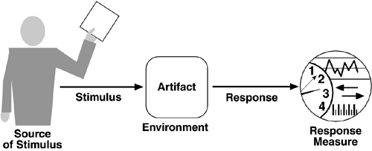
Quality Attribute Scenarios
Notes:
Scenarios with qualities as focus …

Slide 30
Effectiveness of Quality Attribute Scenarios
Quality Attribute Scenarios (QAS) provide a tool to help identifying non-functional requirements
QAS alone will not guarantee that quality aspects are met!
Allow for a systematic approach to deal with quality aspects.
If scenarios are inadequate, do not hesitate to extend them (but with care!)
But:
QAS have proven to be too complex to be useful in the context of “our purpose” ☹
Notes:
I need to explain a few more things here…

Slide 31
“Hypothesis”
Identify the top 3 to 5 quality attributes/factors of the domain
Assume that qualities of similar applications will also be of relevance for the application under consideration
Systematically go through all identified user task
Identify these tasks that make explicit mention of the identified quality attributes
Note: “critical” of user tasks generally imply some quality requirements!
Spell out the resulting non-functional requirements in a verifiable form.
Maybe not be 100% perfect, but a good start…
Notes:
… and this is the process I expect everybody to follow for Assignment 1…

Slide 32
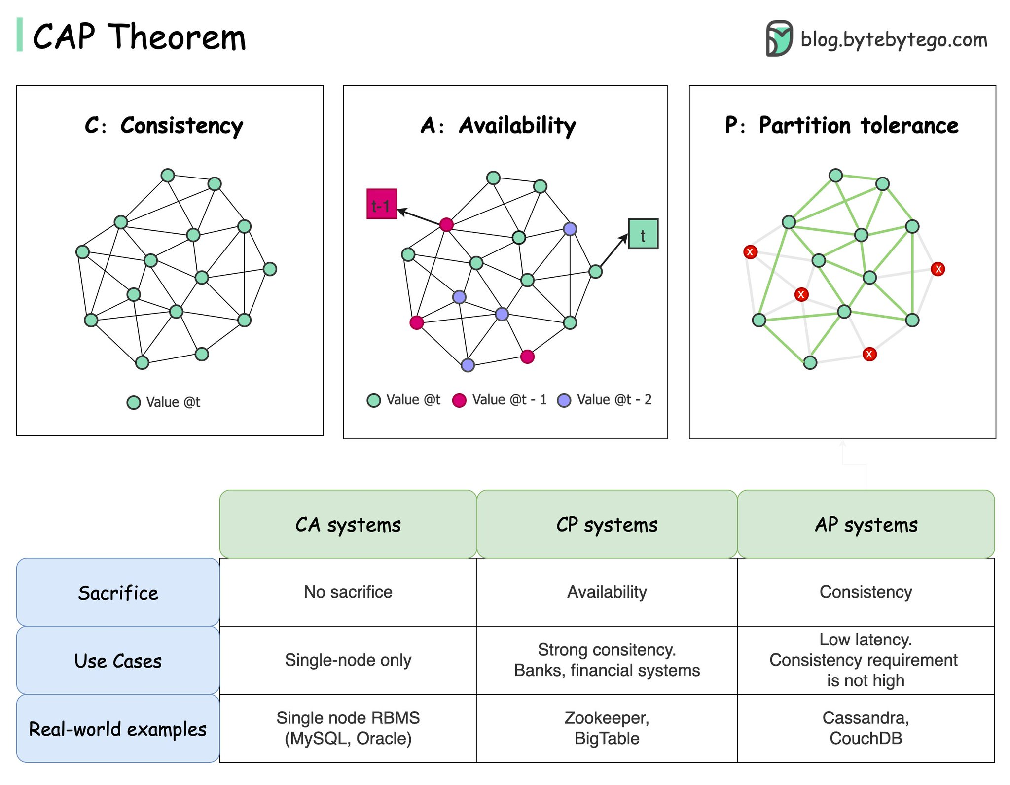

Slide 33
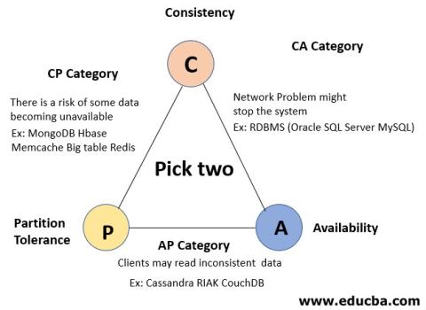

Slide 34
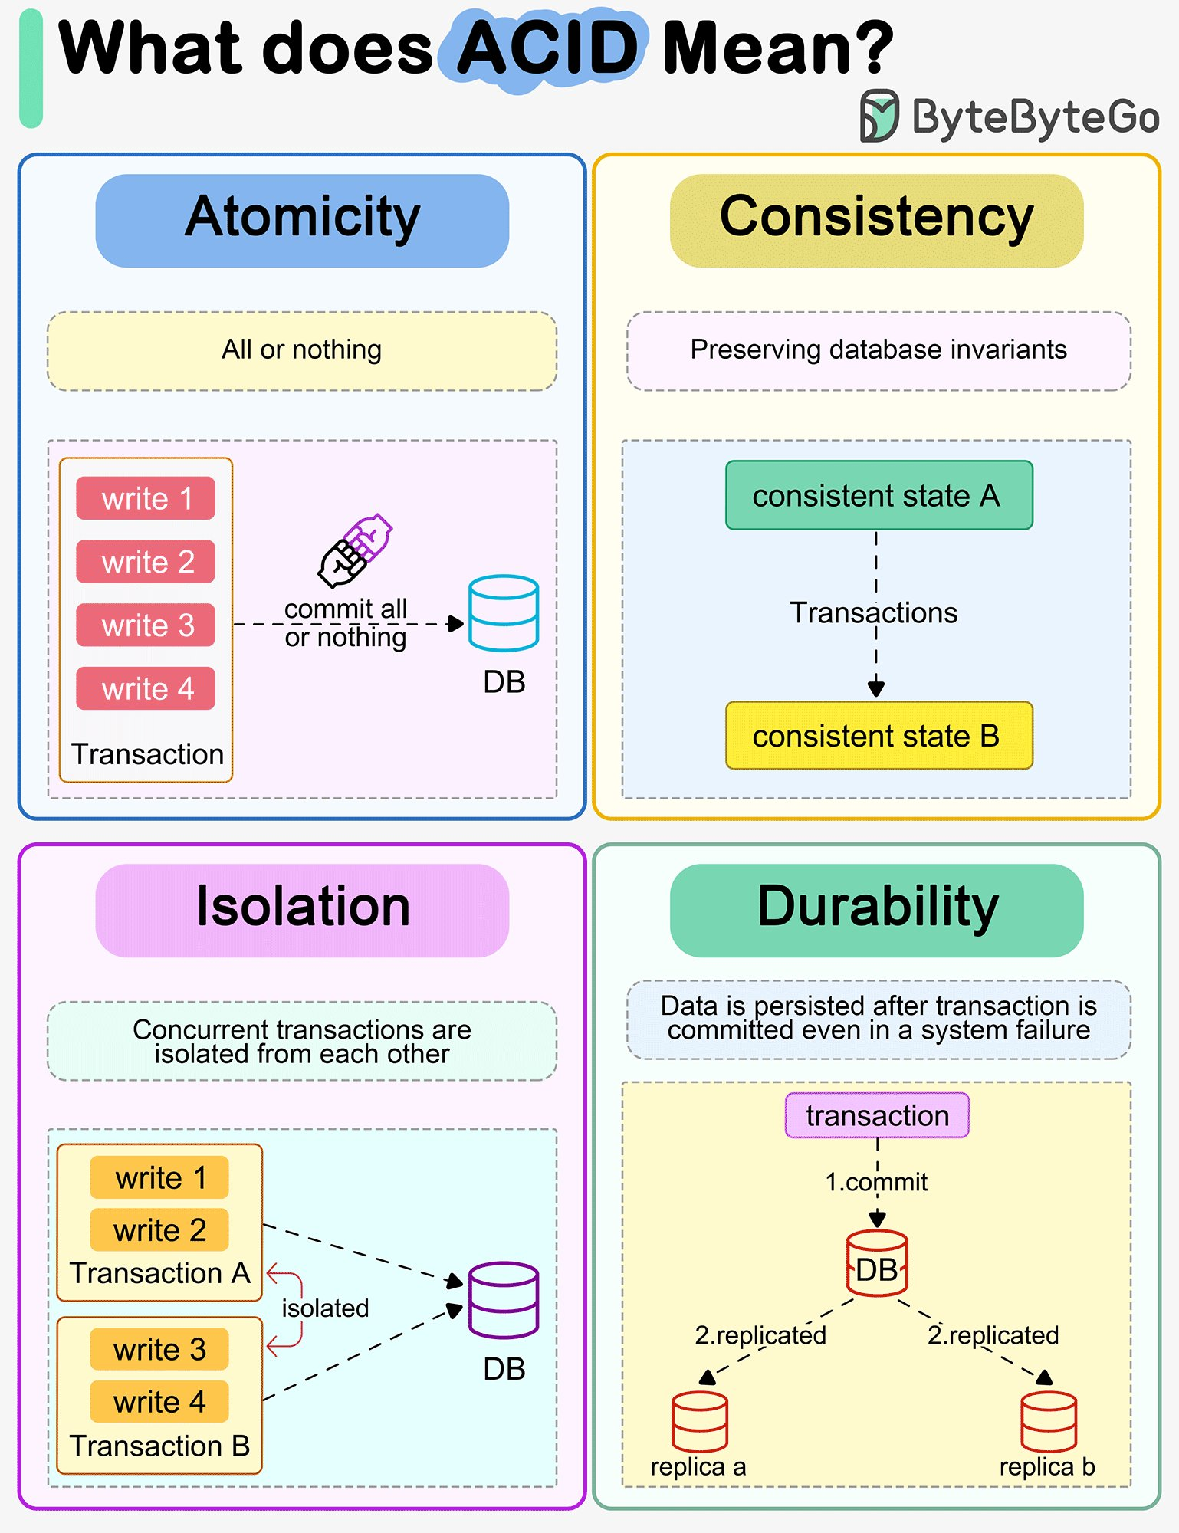

Slide 35
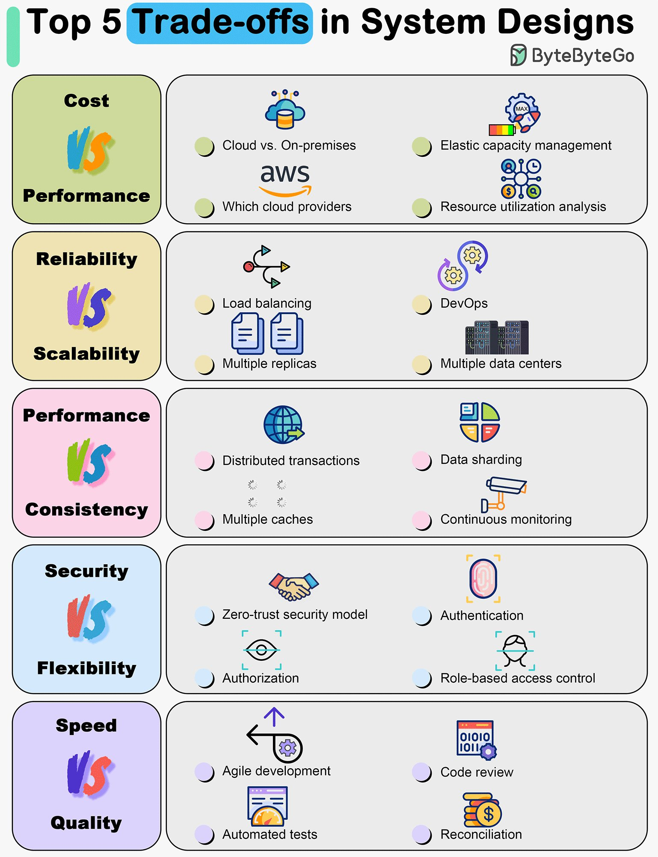

Slide 36
Examples
For the Hotel Information System:
Identify the top 3 to 5 quality attributes/factors …
Systematically go through all identified user task …
User …
“critical” parts …
Spell out the resulting non-functional requirements in a verifiable form …
… see tutorial
Notes:
… and this is the process I expect everybody to follow for Assignment 1…

Slide 37
Outline
Software Quality
Quality Models
Quality Attributes
Quality Attribute Scenarios
Requirements V&V

Slide 38
Validation and Verification
Validation:
Are we building the right product?
do requirements meet stakeholders’ expectations?
are requirements realistic, achievable, prioritized?
can requirements be traced back to business goals?
Verification:
Are we building the product right?
are the requirements implemented correctly?
can you come up with some objective testing scenario?
Notes:
— Boehm (1979)

Slide 39
Traceability
Traceability needed in both forward and backward
directions:
Where did a requirement come from? Does it “origin” from a business goal? What priority does it have?
Where in the design/implementation is this requirement been addressed?
What are the implications on design/implementation if this requirement is changed?

Slide 40
Traceability (cont.)
Goals &
demands
Goal-domain tracing
Domain-reqs tracing
Reviews and tests
Validation
Reqspec
Consistency
checks
System &
accept test
Verification
Direct implementation
Verification
Embedded trace information
Design
Operation
Program
From: Soren Lauesen: Software Requirements
© Pearson / Addison-Wesley 2002

Slide 41
Quality Criteria for a Requirements Spec.
Correct: each requirement reflects a need
Traceable: to goals/purpose (also to design/implementation…)
Complete: all necessary requirements are included
Consistent: all parts of SRS match; there are no inconsistencies
Verifiable: possible to see whether it can be met/tested
Unambiguous: all stakeholders agree on meaning
Ranked for importance/stability: priorities; expected changes
Modifiable: easy to change; maintain consistency
Understandable by customer and developers
Notes:
This slide needs some further elaboration…

Slide 42
I. CRUD Completeness Checks
Guest
Stay
Room
RoomState
Service
ServiceType
Create, Read, Update, Delete + Overview
Entity
Task
Book C U O C O U O
CheckinBooked RU U O O U O
CheckinNonbkd C U O C O U O
Checkout U U O R U
ChangeRoom R R O U O
RecordService O C R
PriceChange C UDO C UDO
Missing? D D C?UD? UD
Notes:
This needs to be explained in more detail…

Slide 43
II. Scenarios
Users interact with a computer system to complete a “task” (or) achieve a “goal” (or have some fun…)
These interactions can be captured as a set of scenarios (or) stories
Each activity in a scenario must be “covered” by one (or possibly more) user tasks
sanity check for completeness!
Notes:
43
Note that scenarios give you “context”, but not necessarily fully complete requirements…

Slide 44
Checking SRS – Contents Check
Introduction, “Context”
System Goals, Business Goals
might also include “Paint Points” or “Pleasure Points”
Data Requirements
domain model (and not a database schema!)
Functional Requirements
include handling of Special Cases
Quality Requirements (“-illities”)
Evidence of validation: reviews, confirmation, CRUD check, scenarios ...
…
May need to add other items based on problem domain and experienced problems!
Evidence of Validation!
Notes:
For the purpose of our work, we also need to add evidence of “Validation”!!!

Slide 45
Checking SRS – Structure Check
Verifiable requirements
Purpose of each requirement
Sample solutions for requirements given
Explanations of graphical illustrations
Do not assume the reader knows what notation is used!!
Importance/stability for each requirement
Cross-references (instead of redundant information)

Slide 46
SRS Sample
Software Requirements Specification document with example - Krazytech

Slide 47
Questions for Consideration
What is throughput? How is it measured? Why is it important to make a distinction between average throughput and peak throughput?
What is scalability? Explain the differences between scaling up and scaling out.
In regards to Security, what is the difference between Authentication and Authorization and how do they provide security to an application?
If one wishes to specify Testability as a quality requirement for a product, how can this requirement possibly be expressed?
What are the most important quality attributes for an online banking system? Explain your rationale.

Slide 48
Question to Answer Week 3
Why can quality attributes, in general, not be considered in isolation? Give two examples of quality attributes that impact other quality attributes for a system under consideration.

Slide 49
Required Reading Lecture 4
Guy Steele, Growing a Language, Journal of Higher-Order and Symbolic Computation, October 1999 (available from Canvas).

